Slide 1

Breast Cancer Detection with CNN
Dissertation Done under the guidance of Dr. Rakesh Nigam
By A S Krishnapriya
PGDM-Finance

Slide 2
Abstract
The identification of breast cancer depends on biomedical images such as mammography scans , histopathological slides which are obtained from biopsies.
Analyzing these images require specialists in the oncology domain, This can lead to uncertainty and differences of opinion among experts. This is where Deep Learning comes in.
In this study : A comparison of performance of Convolutional Neural Networks:ResNet-18, ResNet-50 and ResNet -152 which were trained from scratch to classify malignant and benign breast cancer histopathological slides.
Notes:
Early detection of breast cancer and it’s correct identification can go a long way in not only
saving a woman’s life but also her quality of life.
Computer aided diagnostic techniques step in to resolve such a problem. Breast Cancer Detection using various Deep Learning algorithms by using mammographic
scans and histopathological slides have been carried out by researchers in this domain. This
study aims to compare the performance of ResNet of 3 different depths (a Convolutional Neural
Network) trained from scratch for the task of classifying benign and malignant histopathological
images. Kaiming initialization of weights was implemented and the final layer was replaced
with a fully connected network with softmax activation.

Slide 3
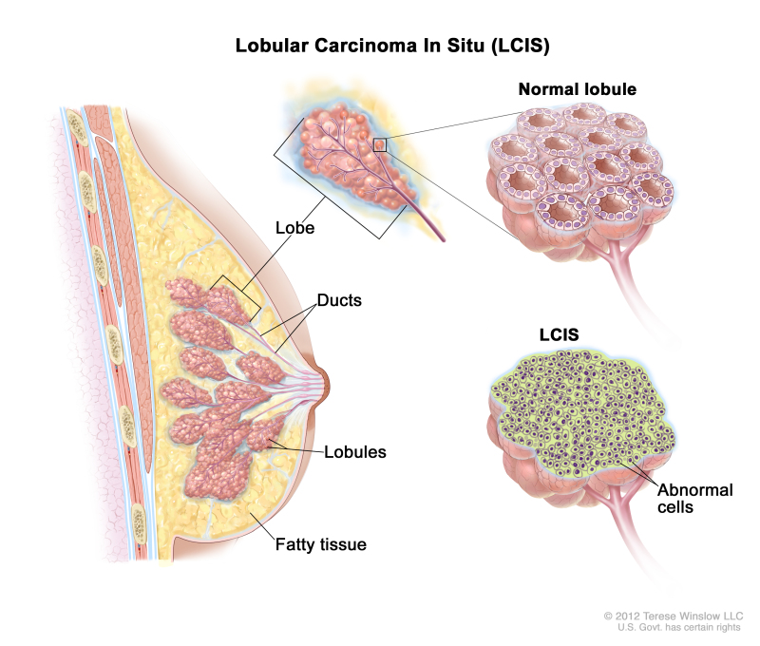
Introduction
The breast consists of
different tissues such as
very fatty tissue to very dense tissue.
A network of lobes lie within
these tissues,and each lobe is
made up of lobules which
are small tube-like structures.
Cancer of the breast is when the cells
present begin to grow out of control
and form a mass of cells. These can be:
Benign or Malignant
Notes:
Blood and lymph vessels are present throughout the structure of the
breast. Cancer of the breast is when the cells present begin to grow out of control and form
a mass of cells. This mass is called a tumor. There are benign tumors as well as malignant.
A benign tumor will not spread to other parts of the body, but a malignant tumor will spread,
and this is called metastasis. [Fer+18] BRCA1/2 genes, increased exposure to radiation,and
increased exposure to estrogen hormone are some of the risk factors for breast cancer. It is
primarily detected by a self examination of the breast by the patient, and upon consulting with
their medical professional usually a mammography, and then if deemed necessary a biopsy is
done.[Rak+18]

Slide 4
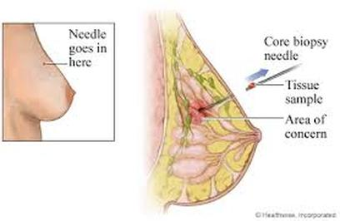
Introduction
Breast cancer can be detected via :
MRI
PET
Ultrasound
Mammography
Biopsy
A biopsy is when a sample suspected cancerous tissue is taken via needle or incision and viewed under a microscope by a professional to identify the tissue as benign or malignant. These images of slides under the microscope are called histopathological images.
Notes:
Mammography, MRI (Magnetic Resonance Imaging), Ultrasound of the breast, PET (Positron
Emission Tomography, thermography are the imaging techniques used to detect a mass or an
1
abnormality in the breast. A biopsy, which is taking a sample of suspected cancerous tissue via
a needle or surgical incision, is done to confirm the the presence of cancer and to identify it
as benign or malignant[Fer+18]. The tissue is studied under the microscope by a professional
and these histopathological images are used to identify which type of benign or malignant form
of cancer it is. This interpretation is a very time consuming and strenuous process as there are
various different types of cancer. However, the correct identification of the histopathological
images is crucial in deciding the course of treatment.[NMK18]

Slide 5
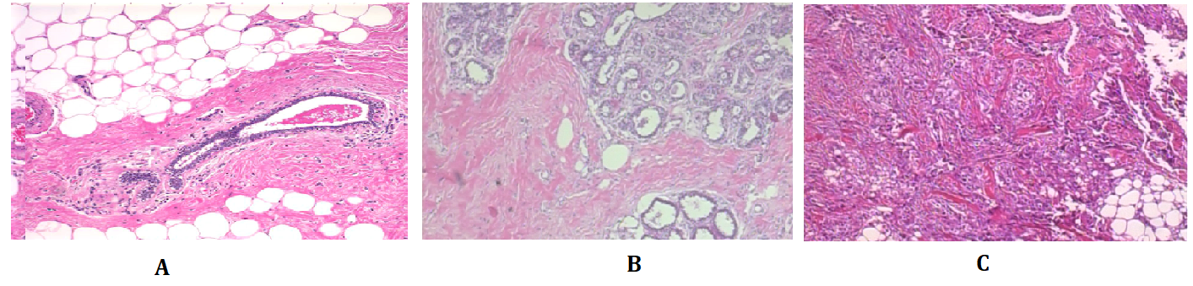
Introduction
During the biopsy, the tissue is collected and stained with hemotoxylin and eosin before analysis by pathologists. The nucleus appears purple and and cytoplasm appears pinkish in colour after staining. It is shown in the figure below.
The nuclei appear purple and cytoplasm appears pinkish. image A is a normal tissue, B is a benign abnormality and C is a cancerous abnormality. We can see the density of nuclei(purple colour) to be dramatically different in the three images.
Notes:
The staining gives a clearer picture by enhancing the nuclei and cytoplasm
of the cells, making it easier to differentiate. 1.1. A pathologist analyzes the
organization of the nuclei, density, variability and the overall structure of the tissues. Cancerous
tissues are distorted in structure and have a higher density of nuclei. The diagnosis process
is extremely crucial and according to a study by Elmore et al. the diagnostic concordance
among specialists is approximately 75 percent. This gives rise to the need to automate such a
labour-intensive task with Computer Aided Diagnostic techniques and improve the accuracy of
diagnosis overall in the medical community. This is where Machine Learning techniques have
emerged to provide reliable and intelligent solutions.
2

Slide 6
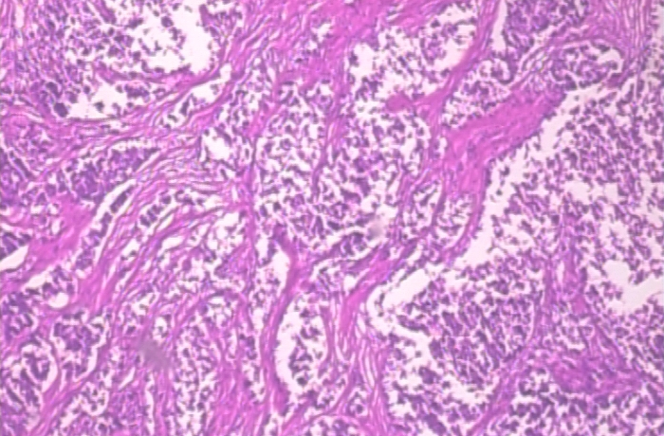
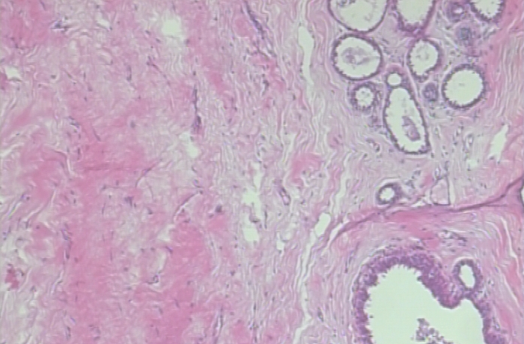
The Dataset
The Breast Cancer Histopathological Image Classification (BreakHis) is composed of :
9,109 microscopic images of breast tumor tissue.
collected from 82 patients.
using different magnifying factors (40X, 100X, 200X, and 400X).
Each image is of size 700x460
A total of 1000 images of all magnifications split into training, testing and validation sets in the ratio 80:10:10 was used.
50% of the total images was malignant and 50% benign.
Malignant
Benign

Slide 7
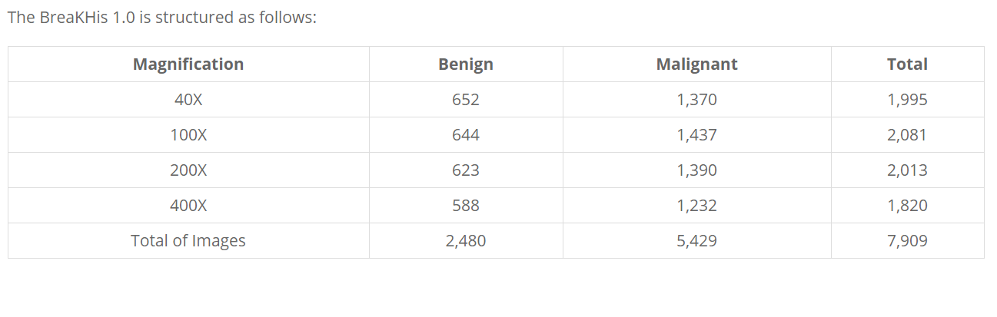
The Dataset
Given here is the summary of the BreakHis dataset

Slide 8
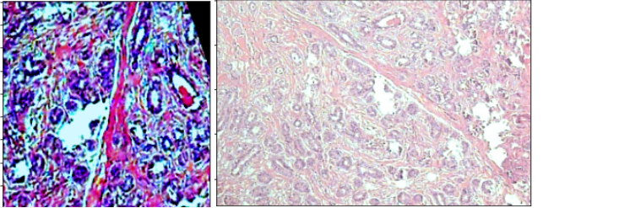
Data Augmentation
Data Augmentation such as :
Randomized Crop and resizing (224x224)
Randomized rotation
Color Jitter (Increasing saturation, contrast)
Were implemented on the test data. Given below is an the augmented and un-augmented image.

Slide 9
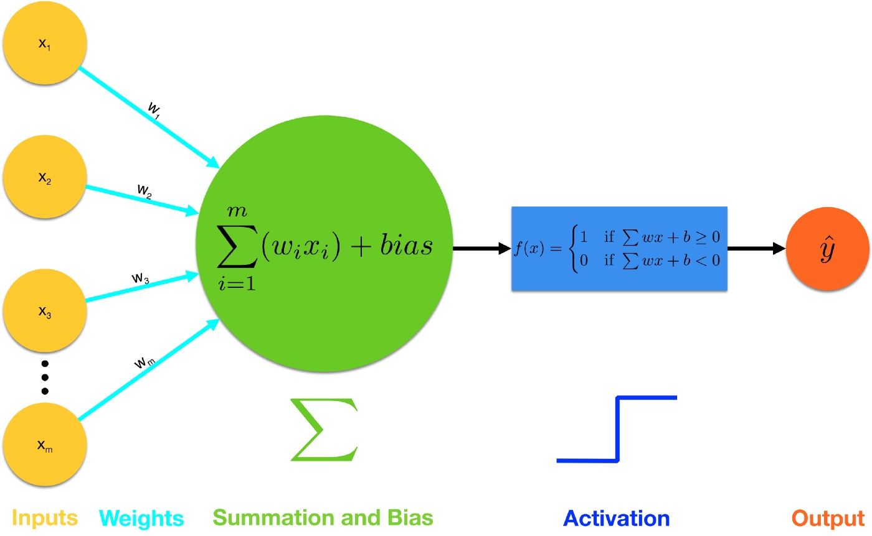
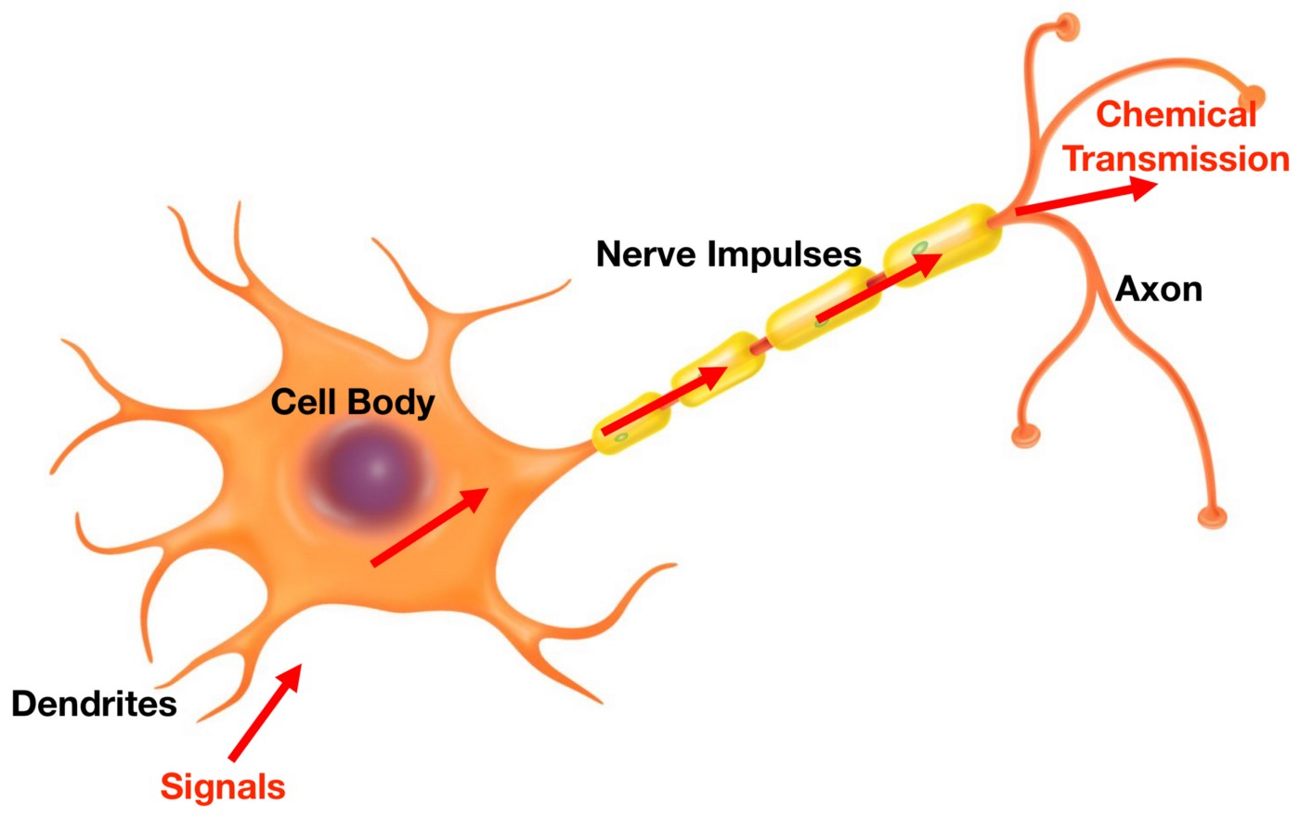
Deep Neural Networks
A description of Neural Networks seems incomplete without drawing parallels to a biological neuron. So to explain what a perceptron is let’s look at an image of a biological neuron and also a Perceptron or an artificial neuron.

Slide 10
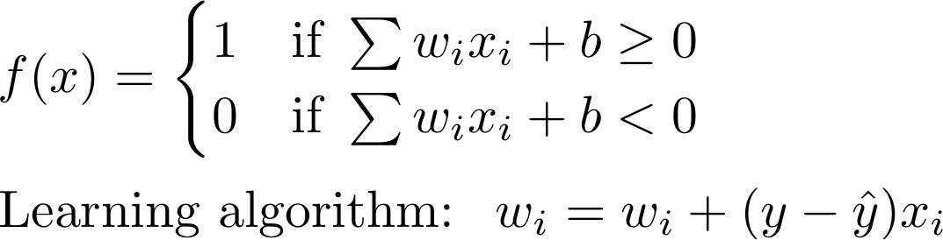
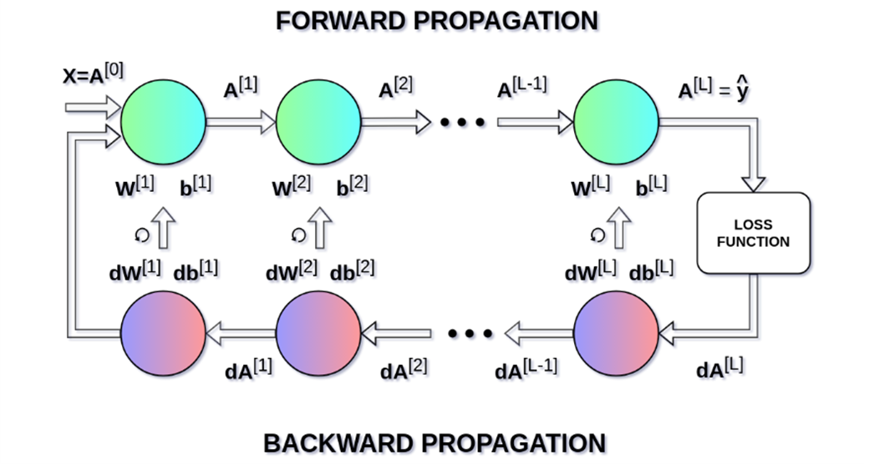
Deep Neural Networks
The kindergarten problem : classification of Living and Non-Living things.
W is the weight, or coefficient of the input term, b acts like the intercept term in the linear equation.
The weights are updated based on the amount of change between y and the predicted output i.e a gradient is calculated, and this is termed as backpropagation.

Slide 11
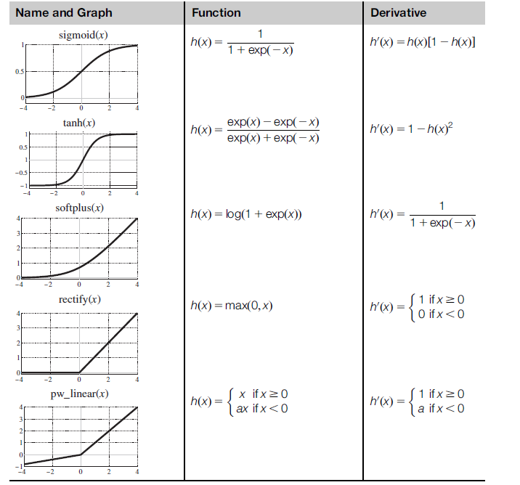
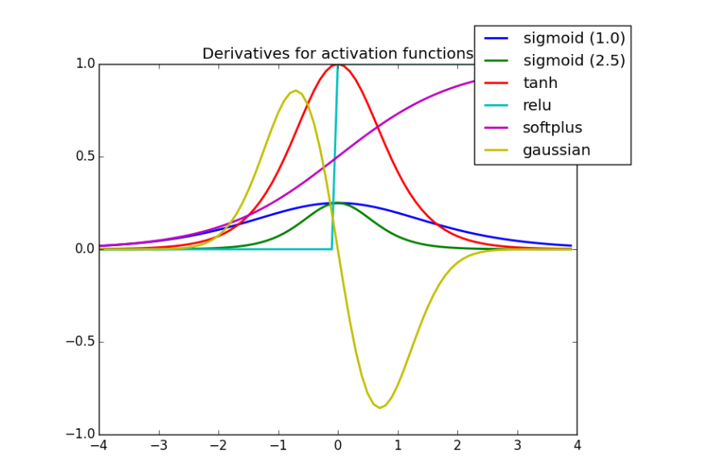
Activation Functions
An activation function or a transfer function is used to get the output from a perceptron. It transforms the output to within a range of 0 to 1 or -1 to 1. There are broadly two types Linear
and Non-Linear Activation functions.

Slide 12
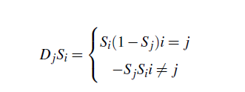
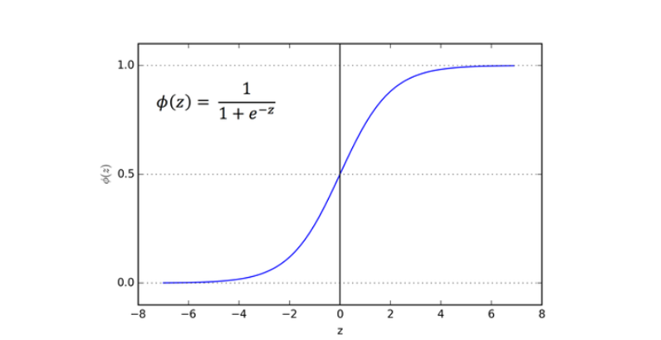
Sigmoid and Softmax functions
This is a differentiable monotonic function. When plotted it takes the form of an S and is used for getting probabilities as the output lies between 0 and 1. The softmax function which is used in this study is a generalised form of this function.
The softmax function is special in the sense that given an input of vectors of real numbers it gives us an output of real numbers such that the values in the output vector sum up to 1.
The derivative of the softmax function is :

Slide 13
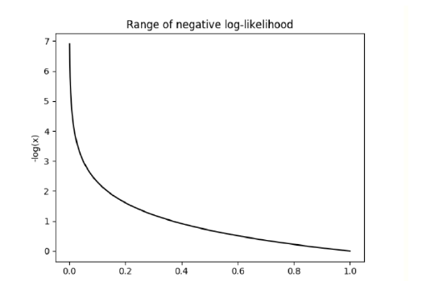
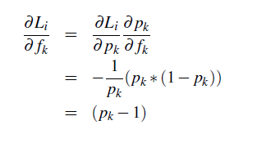
The Loss function
The softmax function is often used with the negative log likelihood function as the Loss function in ML models.
During Backpropagation, the loss function L needs to be differentiated with respect to the output function(classifier), f . In the equations below the final steps in obtaining the derivative are shown, and P is the softmax ouput.

Slide 14
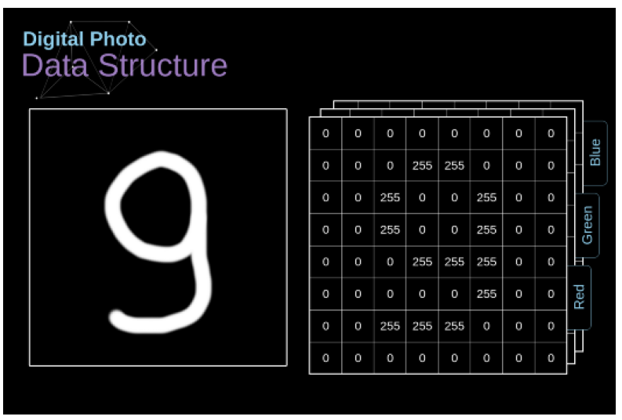
Convolutional Neural Networks
Digital images are actually huge matrices of numbers and each number corresponds to the brightness of a pixel.
In color images, the image is composed of three such matrices corresponding to the three color channels Red, Green and Blue (RGB).
For black and white images, only one matrix is required to store the image.
Each value stored in these matrices ranges from 0 to 255 (256 values fit in 1 byte).

Slide 15
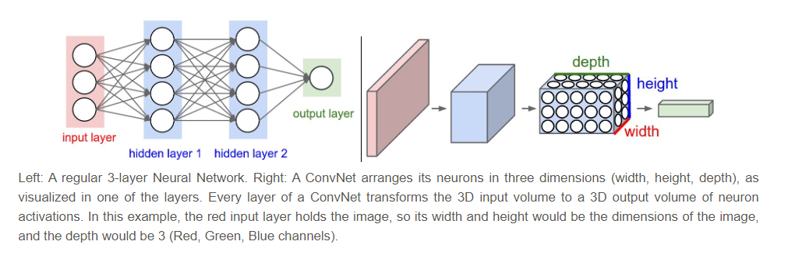
Convolutional Neural Networks
A convolutional Neural Network can be considered a special type of neural network that can process images.
The name arises due to the mathematical operation of convolution, forming the convolutional layer in the network architecture.
The layers of a Convolutional Neural Network have 3 dimensions : height, Width and depth.
A coloured image of size 224 X 224 will have the dimensions 224x224x3.
Notes:
The depth of 3 refers to the Red,Green and Blue color channels of the image. These dimensions at the end of a convolutional neural network get reduced to a single vector of class scores, arranged along the dimension of depth.

Slide 16
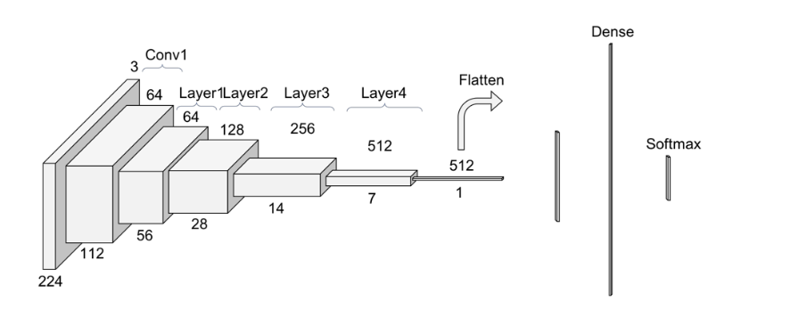
Convolutional Neural Networks
A CNN is a sequence of layers where each layer transforms one set of activations into another through activation functions such as :
Input Layer
Convolutional Layer
ReLu Layer
Pooling Layer
Fully Connected Layer
Notes:
• Input Layer : This layer will hold the raw pixel values of the image. Before an image is
passed through the input layer, it may be resized, or cropped randomly as a part of the
normalisation process.
• Conv layer : This is the feature extraction layer. How this layer works will be discussed
in detail in the following section.
• ReLu Layer: This is an example of a layer with an activation function. The ReLu layer
applies an elemnt wise non-linear activation such as max(0,x) thresholding at zero. This
does not change the size of the input received from the previous Conv layer. This layer
increases the non linearity of the images, i.e the features that have been extracted.
• Pooling Layer : A pooling layer is another building block of a CNN. Its function is
to progressively reduce the spatial size of the representation to reduce the amount of
parameters and computation in the network. Pooling layer operates on each feature map
independently.
• Fully Connected Layer : The Fully Connected Layer will compute the class scores and
classify the images.

Slide 17
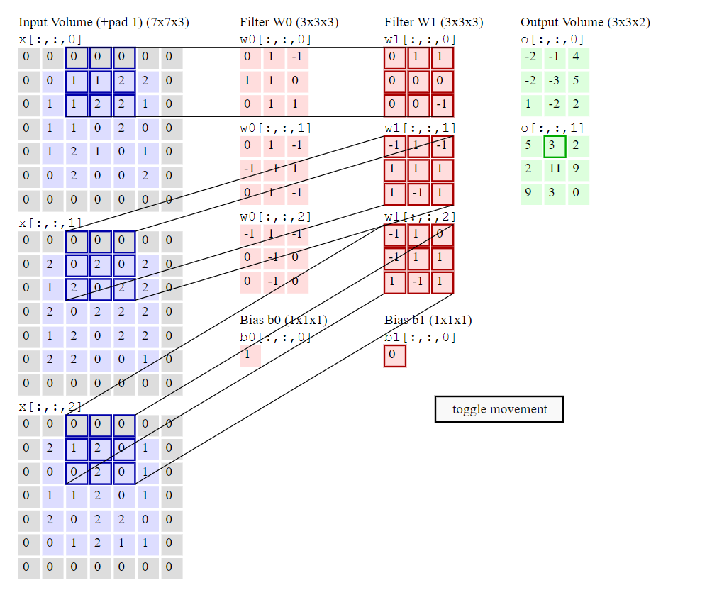
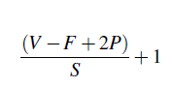
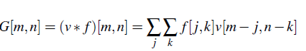
Convolutional Layer
A filter essentially views a small part say 3X3 pixels but views the entire depth of an image i.e all three colors. Each filter slides or convolves across the whole image and computes a dot product between the values in the filter and pixel values.
As we slide over the image with the filter the dot products get computed and are stored on a 2-dimensional activation map.
The size of the output of the convolutional layer is given by:
The equation for convolution:
Notes:
The parameters of this layer are made up
of kernles or filters. We must remember
that an image is essentially a matrix of pixels. An entire set of filters
are present in convolutional layers and each will produce activation maps which will be stacked
to be presented to the next layer. [FRD19]
Essentially, during convolution we take a small matrix of numbers (filter) and pass it our
the image which is a matrix of pixel values, a dot product is computed between them.

Slide 18
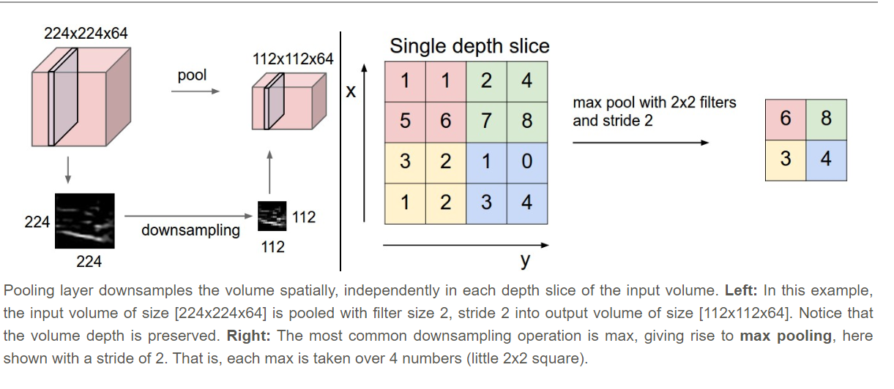
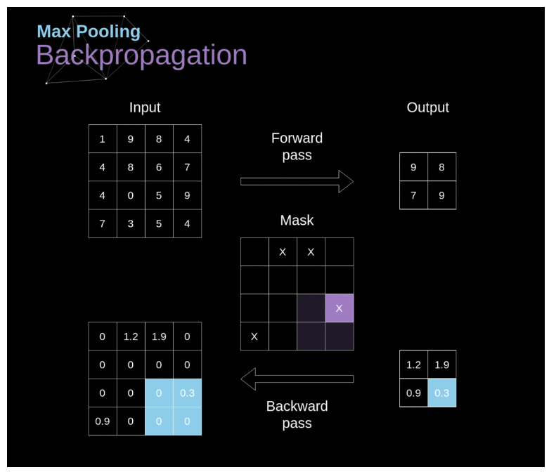
Pooling Layer
Pooling layers are primarily used to reduce the size of the tensor (3 Dimensional matrix) and to speed up calculations. It reduces the size and also reduces the chance of over-fitting.
During backpropagation, the gradient does not affect the elements that were not included in the forward pass in this layer.
Notes:
Pooling layers are primarily used to reduce the size of the tensor (3 Dimensional matrix) and
to speed up calculations. It reduces the size and also reduces the chance of over-fitting. We
take the example of the commonly used Max Pool Layer, where we select the maximum value
from each region and place it in the output correspondingly. Again, here we have two hyperparameters
available for this layer, filter size and stride. Pooling for multi-channel images are
done separately for each channel.
During backpropagation, the gradient does not affect the elements that were not included
in the forward pass in this layer. The position of the elements used are marked (a mask) and
used to calculate gradients in the backpropagation. This is illustrated in the figure.

Slide 19
Example of a CNN
A basic block consisting of :
Convolutional layer (kernel size =4, with56 features)
a batch normalization layer
ReLu layer
Convolution layer (kernel size =4, with 56 features)
Relu layer
with a pooling layer (Max Pooling, kernel size = 2) in between every 5 units .This unit is repeated 5 times (so as to sufficiently flatten the input matrix).
Input image size is 224, maxpooling flattens it by half, and doing so 5 times would arrive at a flattened image of 7x7 which is used for classification.
Notes:
Initially in this study a network with the following architecture was arrived at :
a basic block consisting of :
Convolutional layer (kernel size =3)
a batch normalization layer
ReLu layer
Convolution layer (kernel size =3)
Relu layer
with a pooling layer in between every 5 units was attempted.
This unit was repeated times (so as to sufficiently flatten the input matrix).

Slide 20
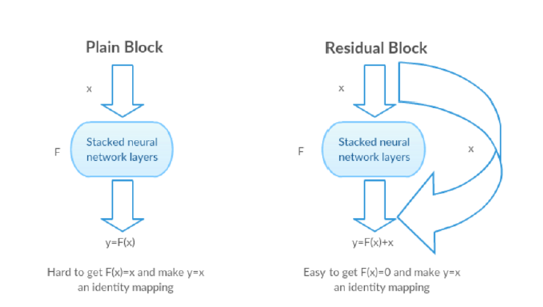
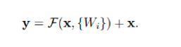
ResNet
Developed by Kaiming He, Xiangyu Zhang, Shaoqing Ren and Jian Sun, ResNet was a novel solution to the vanishing gradient problem.
With ResNets, the gradients can flow directly through the skip connections backwards from later layers to initial filters.
A residual function is defined as: F(x) = H(x) -x. This can be reframed as F(x) + x = H(x). Here the F(x) represents the stacked non-linear layers and x represents the identity function.
Notes:
ResNet or Residual Networks solve an important problem that arises while training networks.
As the depth of the network increases, there is a degradation in accuracy. This is because as the
layers get deeper and many activation functions are used, the output from each layer gets smaller
and smaller due to the activation functions. For example the sigmoid function gives an output
between 0 and 1. The input gets significantly reduced by the sigmoid function. This becomes
a problem as during backpropagation. During backpropagation, the derivatives of the network
parameters (weights and bias) are found from the final layer to the initial layer. By chain rule,
these derivatives get multiplied through the network to compute the derivatives of the initial
layers. So, if we were to use an activation such as a sigmoid function for l hidden layers, l small
derivatives get multiplied and gradient diminishes drastically. Because of a very small gradient,
the weights and biases do not get updated properly. This is termed as the vanishing gradient
problem.[He+15]
Residual Networks solve this problem in a novel manner, A residual function is defined as
: F(x) = H(x) -x. This can be reframed as F(x) + x = H(x). Here the F(x) represents the stacked
non-linear layers and x represents the identity function.
It is easier to make F(x) = 0 than F(x) = x using stacked non-linear layers of a cnn. This
F(x) is called the residual function This is the intuition behind the residual Block as illustrated
by the figure 4.25
42

Slide 21
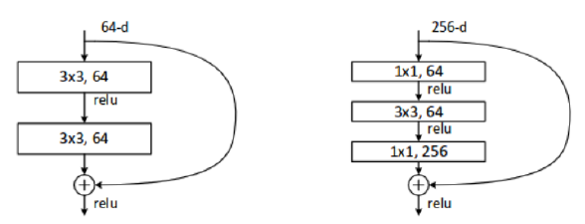
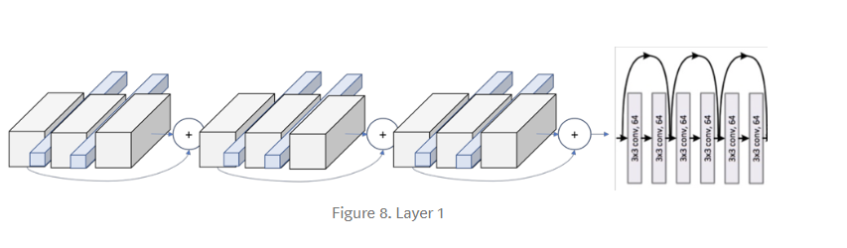
ResNet
A ResNet block is either 2 layer deep or 3 layer deep.
That is, the skip connections occur after two layers or 3 layers.
Notes:
Each ResNet block is either 2 layer deep (Used in small networks like ResNet 18, 34) or 3
layer deep( ResNet 50, 101, 152). These are known as bottlenecks. The bottleneck in a neural
network is just a layer with less neurons then the layer below or above it. Having such a layer
encourages the network to compress feature representations to best fit in the available space, in
order to get the best loss during training. A building block of Resnet is illustrated in figure

Slide 22
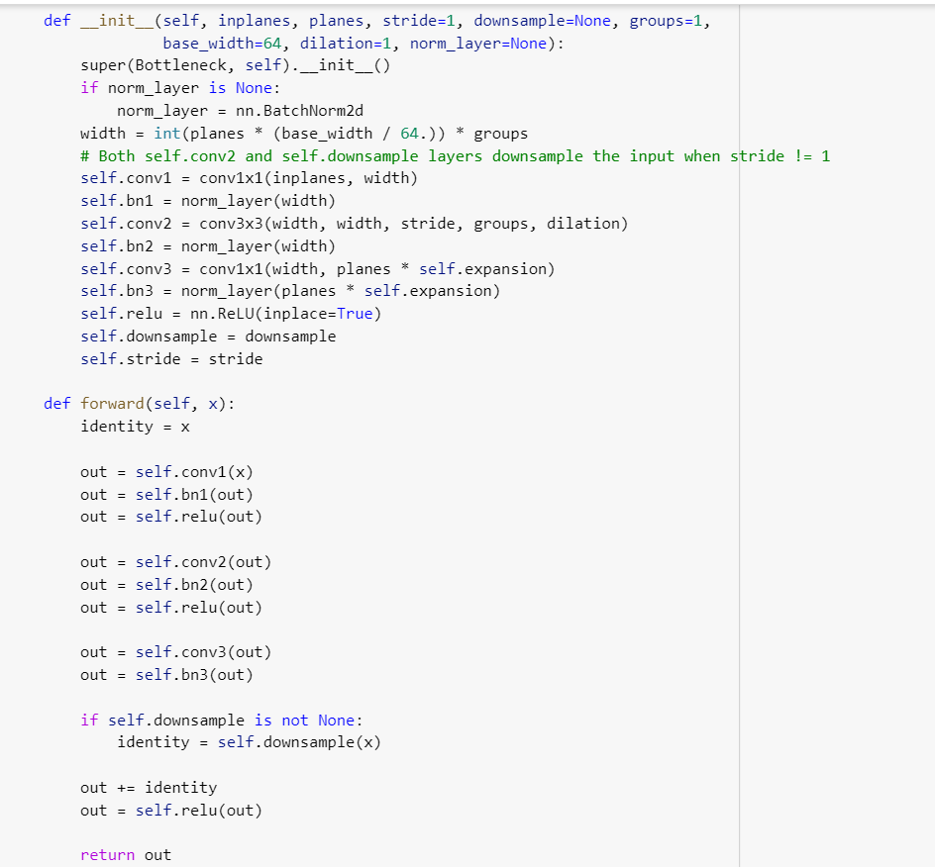
ResNet
In this study ResNet was coded using Pytorch.
Each convolutional layer, its stride, kernel size, input size, output size can be defined.
The layers are stacked in a conv-batch normalization-ReLu pattern.
The identity function: input passed through the first convolutional is added in the end before the final ReLu layer. This is a two block skip connection.

Slide 23
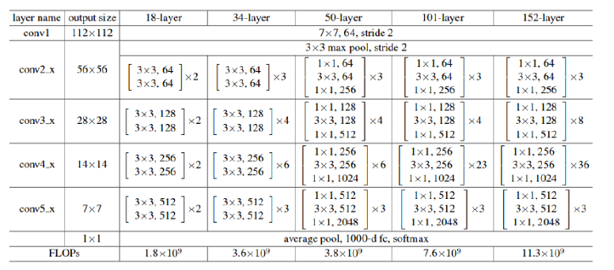
ResNet
Notes:
So, first there is a convolution operation. In the Figure 1 we can see that they use a kernel size of 7, and a feature map size of 64. You need to infer that they have padded with zeros 3 times on each dimension — and check it on the PyTorch documentation. Taken this into account, it can be seen in Figure 4 that the output size of that operation will be a (112x122) volume. Since each convolution filter (of the 64) is providing one channel in the output volume, we end up with a (112x112x64) output volume — note this is free of the batch dimension to simplify the explanation.

Slide 24
Regularization and Parameter Initialization
An L2, regularization (Ridge Regression), early stopping, and dropout were implemented in all three models.
Parameters were initialized with kaiming initialization :
In their 2015 paper, He et. al. demonstrated that deep networks (e.g. a 22-layer CNN) would converge much earlier if the following input weight initialization strategy is employed:
Create a tensor with the dimensions appropriate for a weight matrix at a given layer, and populate it with numbers randomly chosen from a standard normal distribution.
Multiply each randomly chosen number by √2/√n where n is the number of incoming connections coming into a given layer from the previous layer’s output (also known as the “fan-in”).
Bias tensors are initialized to zero.
This keeps the weight distributions mean getting incremented slowly layer by layer and variance close to 1

Slide 25
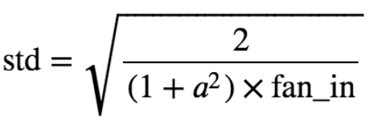
Regularization and Parameter Initialization
Kaiming Initialization can be mathematically represented as :
Where
a: the negative slope of the rectifier used after this layer (0 for ReLU by default)
fan_in: the number of input dimension. If we create a (784, 50), the fan_in is 784. fan_in is used in the feedforward phase. If we set it as fan_out, the fan_out is 50. fan_out is used in the backpropagation phase.

Slide 26
Results
All three models were trained from scratch for 300 epochs with early stopping implemented.
The optimizer used was Stochastic Gradient Descent with momentum.
ResNet-152 outperformed among the three.
This could be because of the depth of the network and the number of residual bottlenecks being much larger than the other two.
This is consistant with many other studies that used pretrained weights where ResNet-152 outperformed others.

Slide 27
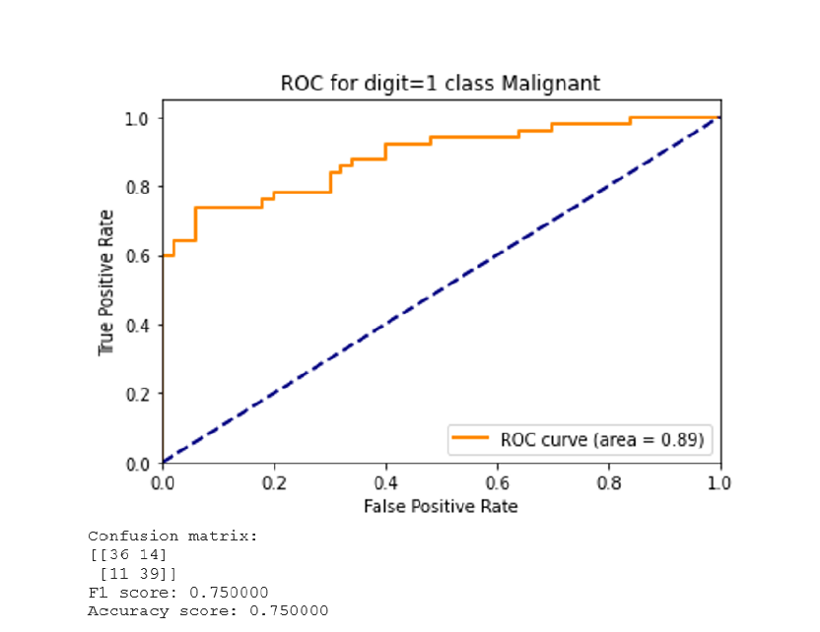
Results: ResNet 152

Slide 28
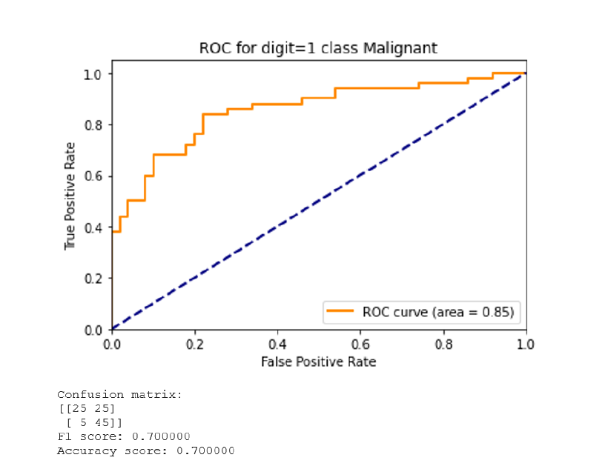
Results: ResNet 50

Slide 29
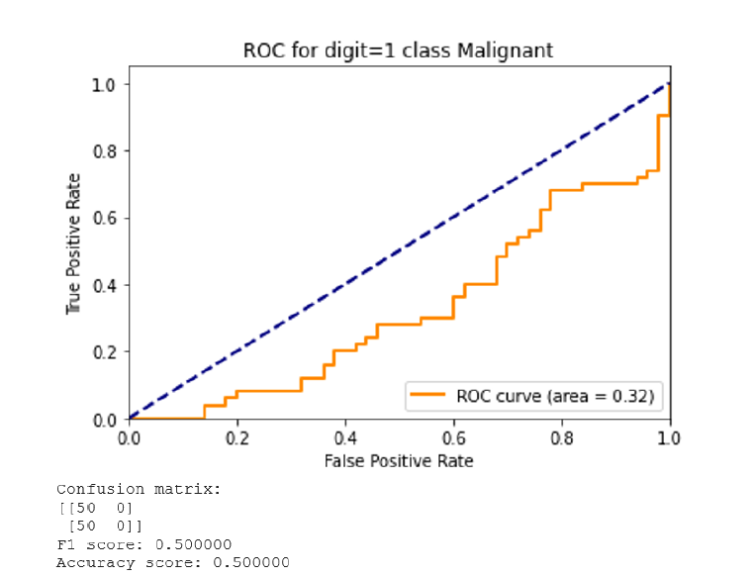
Results: ResNet 18

Slide 30
Results
Network | Validation Accuracy | Test Accuracy | F1 Score | AUC
ResNet-152 | 0.78 | 0.75 | 0.75 | 0.89
ResNet-50 | 0.72 | 0.70 | 0.70 | 0.85
ResNet-18 | 0.52 | 0.50 | 0.5 | 0.32
Notes:
For ResNet-152 the best accuracy in the validation phase was 0.78 and in the test was the
accuracy and F1 sore was 0.75. An AUC of 0.89 was recorded by the model.
For ResNet-50 the best accuracy in validation phase was 0.72 and in test the accuracy was
0.70. An AUC of 0.85 was recorded. ResNet 18 was the worst performer, with a validation
phase accuracy of 0.52 adn an accuracy of 0.5 on the test phase. An AUC score of 0.32.
The results are in conjecture with literature, as they have shown ResNet-152 to outperform
the others. The poor performance of ResNet-18 could be attributed to the different bottleneck
structure (1 layer) whereas ResNet-50 and ResNet-152 posses the 2 layered bottleneck and are
also much deeper compared to ResNet-18.

Slide 31
Challenges and Constraints
Very large amounts of data is required to effectively train a CNN. The ImageNet dataset for example consists of millions of images.
Computing power i.e GPU and high RAM capacity is also required to train CNN for image datasets.
To work around these constraints :
Google Colaboratory a cloud platform providing GPU facility was used.
But this in turn brought up additional issues as google drive was not accommodative of the entire dataset, and when the RAM was still insufficient to process a dataset of more than 1000 images in total.
Notes:
In order to train a Convolutional Neural Network to effectively classify images large amounts
of data and computing power is required. In this study, due to constraints a total of thousand
images of various magnifications were taken from the database and split into training, testing
and validation sets in the ratio 80:10:10 . The data was uploaded into Google Drive which was
then mounted onto the Google Colaboratory environment.Google Colab is a cloud platform that
provides Graphics Processing Units or GPUs to be used remotely. A lot of researchers in Deep
Learning use this platform. The code to mount the data onto the environmetn is given in the
figure 3.5. The availability and accessibility of sufficient training data was a major constraint in
this study.
The Colaboratory platform solved a few issues, but not all of them.
Though GPU was present, but even for 10 images custom networks took too long to train.
A constant and steady internet connection was required.
Training time took hours.

Slide 32
The way Forward
To create an ensemble classifier of ResNets, and perhaps even a hybrid ensemble and study the performance of such a classifier.
Using pretrained weights and then replacing the final layers with custom networks is a popular approach in attempts to further research in this field.
In this study, only a broad classification i.e binary classification was attempted. The next step would be for a multi-class classification, to the type of cancer. A network should be unbiased and equally sensitive to all classes. Advanced Data Augmentation techniques such as the usage of conditional General Adversarial Networks and deep photo style transfer is another avenue that can be explored.
Different weight initialization techniques such as Xavier, Gaussian distribution, MSRA are some other options. In this study Kaiming initialization of weights was attempted.

Slide 33
References
Debra M. Ikeda et al. “Computer-aided Detection Output on 172 Subtle Findings
on Normal Mammograms Previously Obtained in Women with Breast Cancer
Detected at Follow-Up Screening Mammography”. In: Radiology 230.3 (2004).
PMID: 14764891, pp. 811–819. DOI: 10.1148/radiol.2303030254. eprint:
https://doi.org/10.1148/radiol.2303030254. URL: https://doi.org/
10.1148/radiol.2303030254.
I.H. Witten, E. Frank, and M.A. Hall. Data Mining: Practical Machine Learning
Tools and Techniques. The Morgan Kaufmann Series in Data Management Systems.
Elsevier Science, 2011. ISBN: 9780080890364. URL: https : / / books .
google.co.in/books?id=bDtLM8CODsQC.
Kaiming He et al. “Deep Residual Learning for Image Recognition”. In: CoRR
abs/1512.03385 (2015). arXiv: 1512.03385. URL: http://arxiv.org/abs/
1512.03385.

Slide 34
Ian Goodfellow, Yoshua Bengio, and Aaron Courville. Deep Learning. http :
//www.deeplearningbook.org. MIT Press, 2016.
Benzheng Wei et al. “Deep learning model based breast cancer histopathological
image classification”. In: 2017 IEEE 2nd International Conference on Cloud
Pytorch Documentation. Pytorch Documentation. Web resource. The code was
built used on the documentation available from here. 2017. URL: Pytorch.org.
Lisa Licitra, Annalisa Trama, and Hykel Hosni. “Benefits and Risks of Machine
Learning Decision Support Systems”. In: JAMA 318.23 (Dec. 2017), pp. 2354–
2354. ISSN: 0098-7484. DOI: 10.1001/jama.2017.16627. eprint: https://
jamanetwork.com/journals/jama/articlepdf/2666496/jama\_licitra\
_2017\_le\_170143.pdf. URL: https://doi.org/10.1001/jama.2017.
16627.

Slide 35
Thank You
I’d like to record my sincere gratitude to Dr.Rakesh Nigam for his constant encouragement and guidance. To the institution for granting me the opportunity to take on such a study. To my parents and friends for their support. And to God, for his blessings.

